Slide 1
Tokamak Network HR Solution Demo Day
What's New — 2026.04.15 ~ 04.22

Slide 2
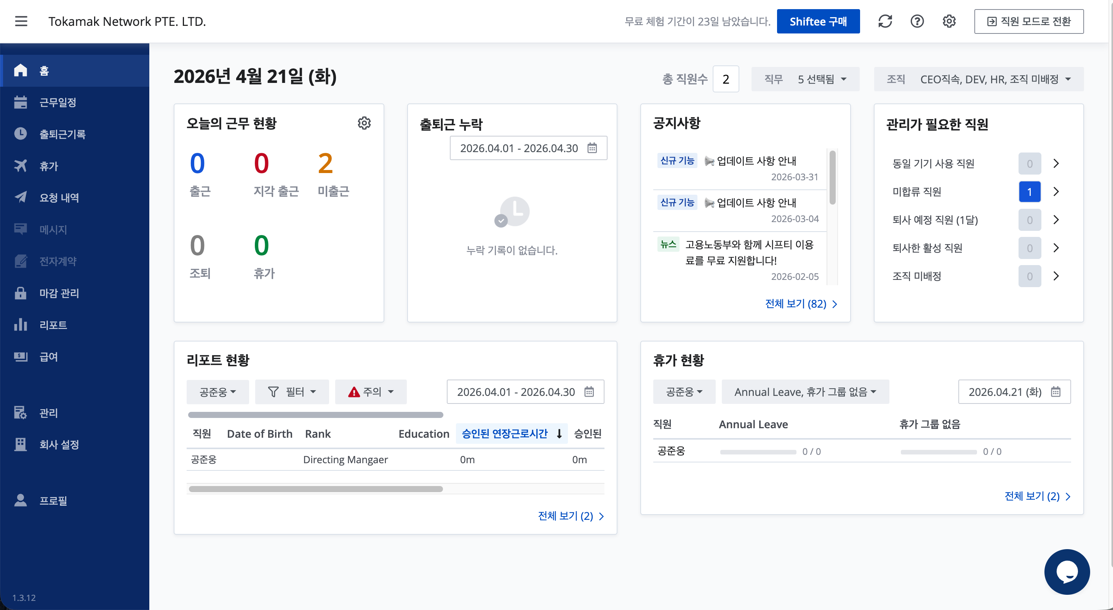
Benchmarking & Reference
Reference: Shiftee (시프티)
- Korean HR SaaS used by 10,000+ companies
- We're benchmarking their UX patterns for our solution
What We Adopted
- Consistent button layout (Import / Export / Template)
- Corporate bank account management module
- Dashboard with attendance & status cards
- Sidebar navigation structure
What We Do Differently
- Crypto-native: USDT salary, on-chain TX tracking
- Etherscan integration for wallet monitoring
- Built-in developer sourcing (LinkedIn + GitHub)

Slide 3
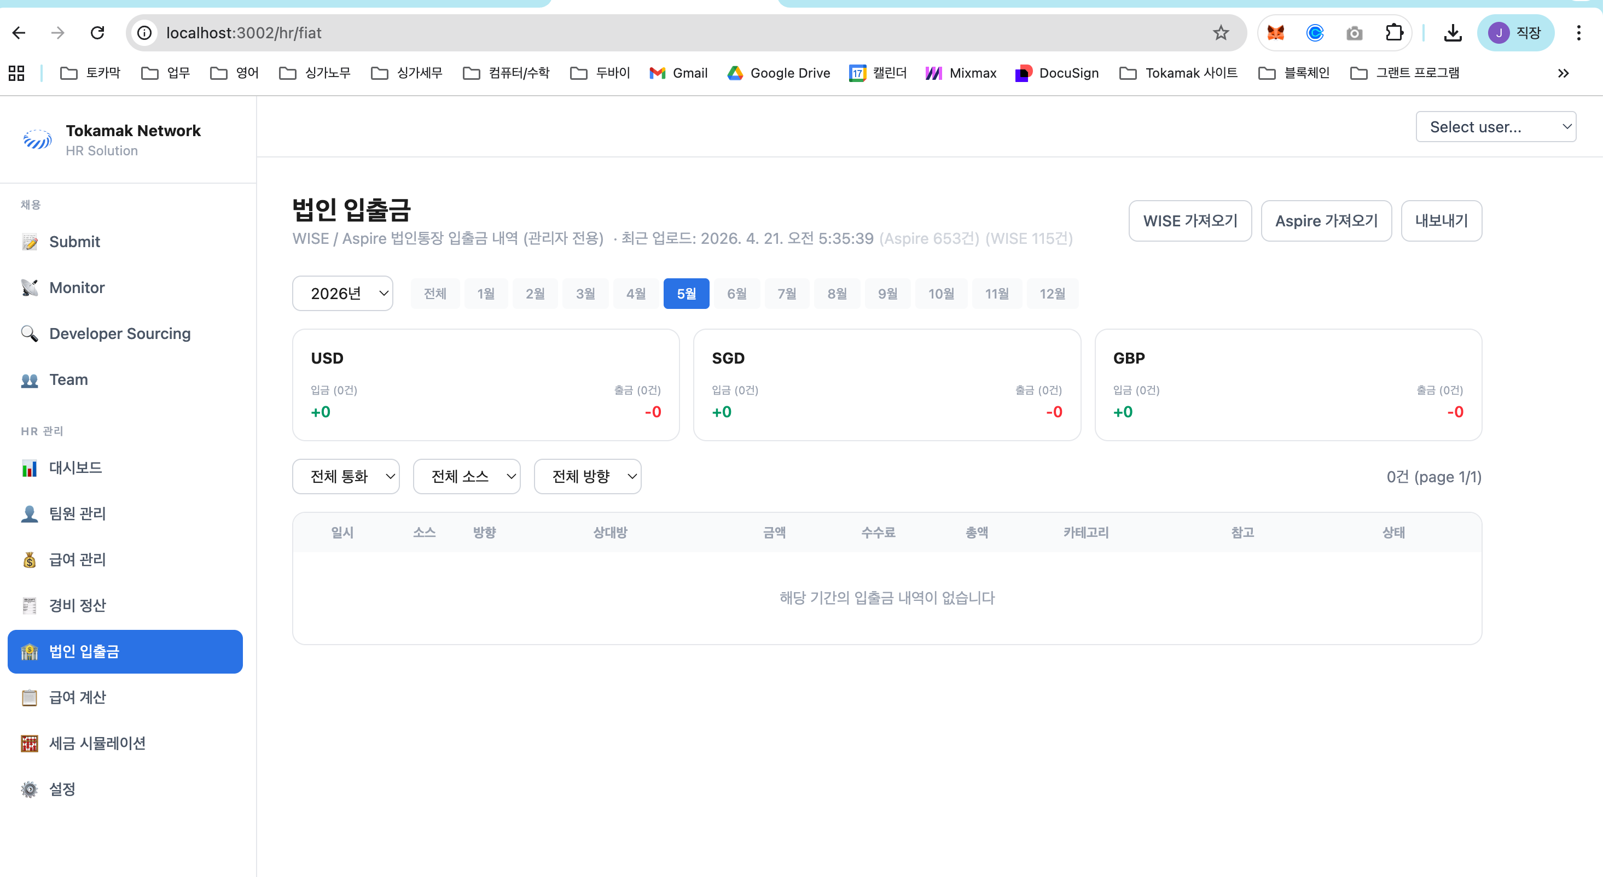
Corporate Bank Records
New: Fiat Transaction Management
- Upload WISE CSV and Aspire Excel statements
- Filter by year, month, currency (USD/SGD/GBP), and source
Fee Tracking
- Shows net amount, fee, and gross (fee-included) amount
- Useful for cross-border and multi-currency operations
Safe Re-Upload
- Duplicate transactions are skipped automatically (by TX ID)
- Shows last upload time and record count per source

Slide 4
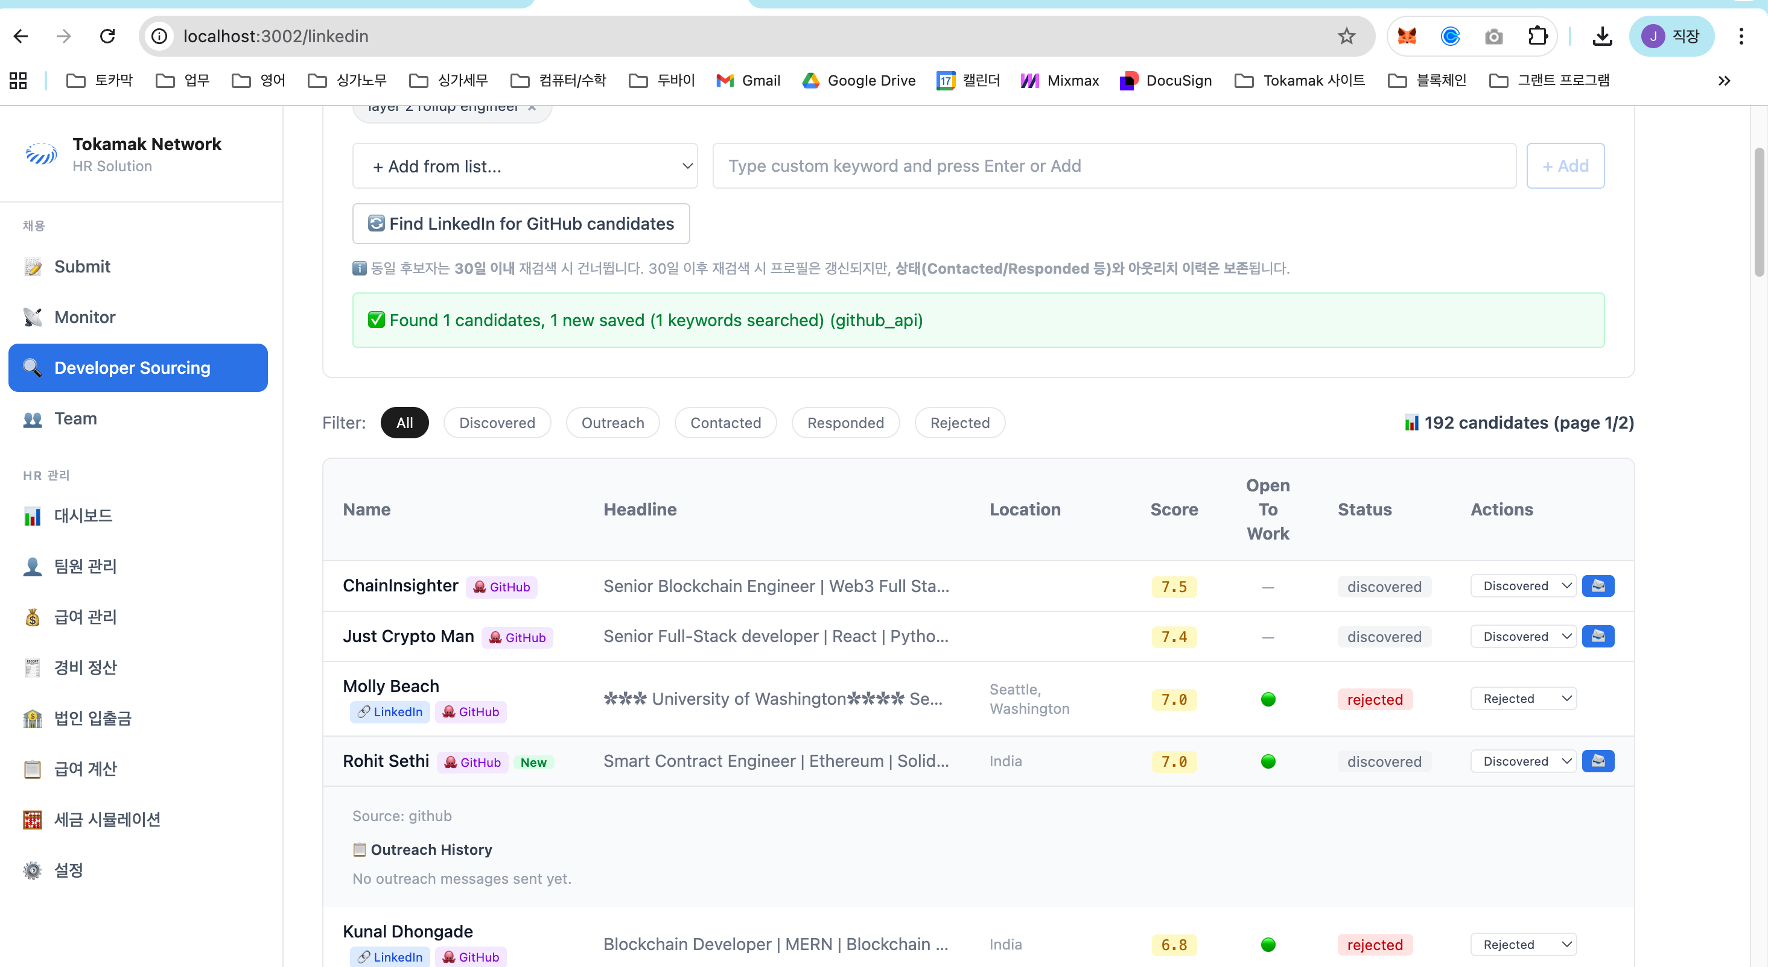
Developer Sourcing — Improved
History Preservation
- Re-search after 30 days now keeps status and outreach history
- Contacted / Responded / Rejected status is never lost
New vs Returning Candidates
- 'Nx seen' badge shows how many times a candidate appeared
- Expanded row shows first seen, last searched, source
Pagination
- Browse all candidates with 100 per page
- Total count and page number displayed

Slide 5
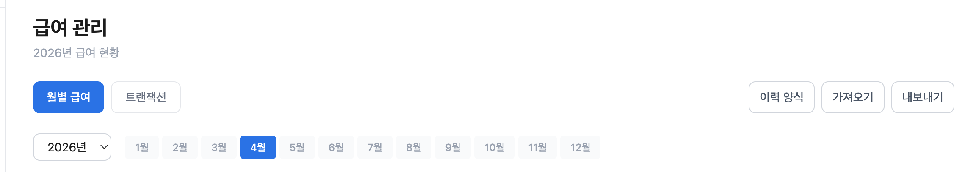
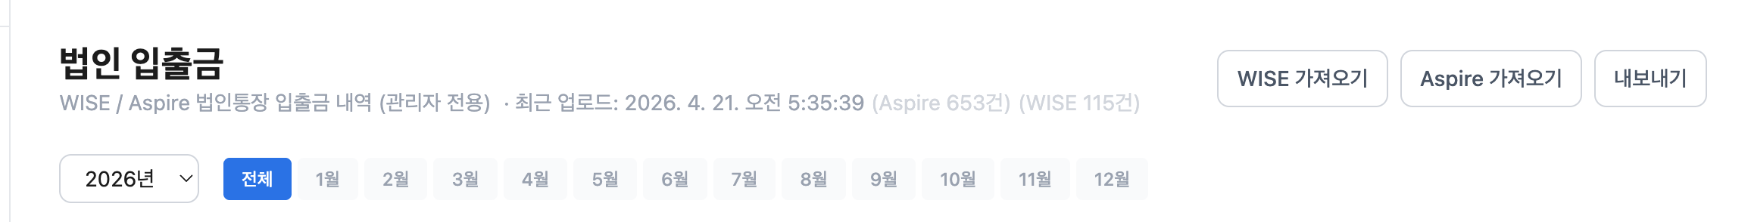
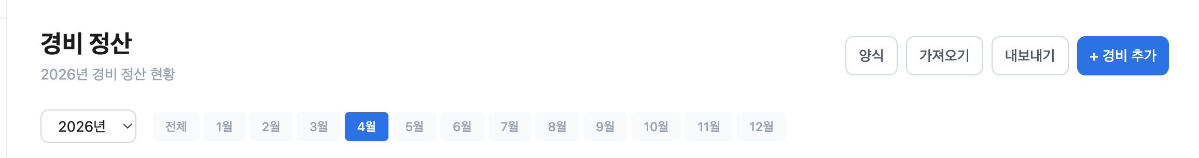
UX Improvements
Unified Button Labels
- Import (upload) / Export (download) / Template (format)
- Consistent across all pages: Team, Payroll, Expenses, Fiat
Better Data Display
- Click any row to expand full details
- Fixed-width table columns for clean alignment
- Status labels translated to Korean
Updated Branding
- Sidebar: Tokamak → Tokamak Network
- Enlarged logo with tighter spacing

Slide 6
Thank You
Tokamak Network HR Solution

